Slide 1
Build a classification model to classify stars category
Presented by :
jehad bin musallam

Slide 2
OUTLINE:
Introduction
Tools
Workflow
Data
EDA-Analysis
Models
Conclusion
Future work

Slide 3

Introduction
In this project my task was to get a dataset to build a classification model to classify stars category .
Goals
Build a classification models to predict stars category
Choose the model that give us the best predict.

Slide 4
TOOLS
Jupyter
Matplotlib.
Seaborn.
Pandas.
sklearn.
numpy.
pickle

Slide 5
Workflow
Loading
Data
EDA
Building Models
Choosing the best Model

Slide 6
Data Description:
We used the dataset from https://www.kaggle.com
The dataset contains 39552 rows and 7 columns
Features:
Vmag:Visual Apparent Magnitude of the Star.
Plx:Distance Between the Star and the Earth.
e_Plx:Standard Error of `Plx`.
B-V:B-V color index.
SpType:Spectral type.
Amag:Absolute Magnitude of the Star.
TargetClass:Whether the Star is Dwarf (0) or Giant (1).

Slide 7
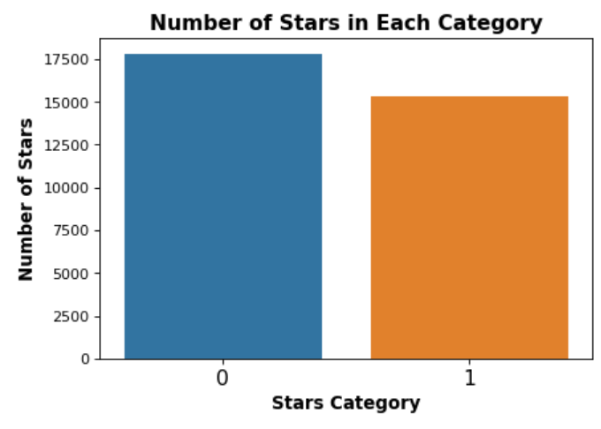

EDA
01
Removing Null
02
Removing duplicate rows
03
04
Convert categorical data to dummies
Removing outliers
Dwarf
Giant
Balance
matrices accuracy

Slide 8
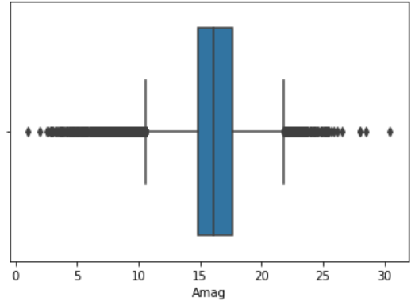
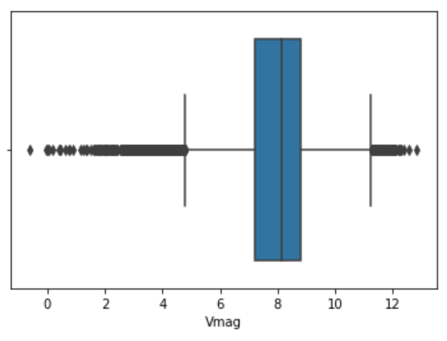
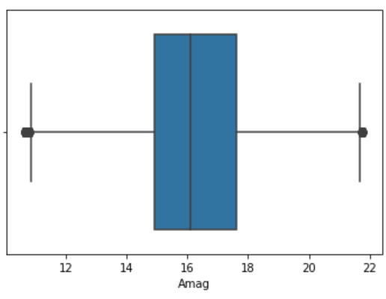
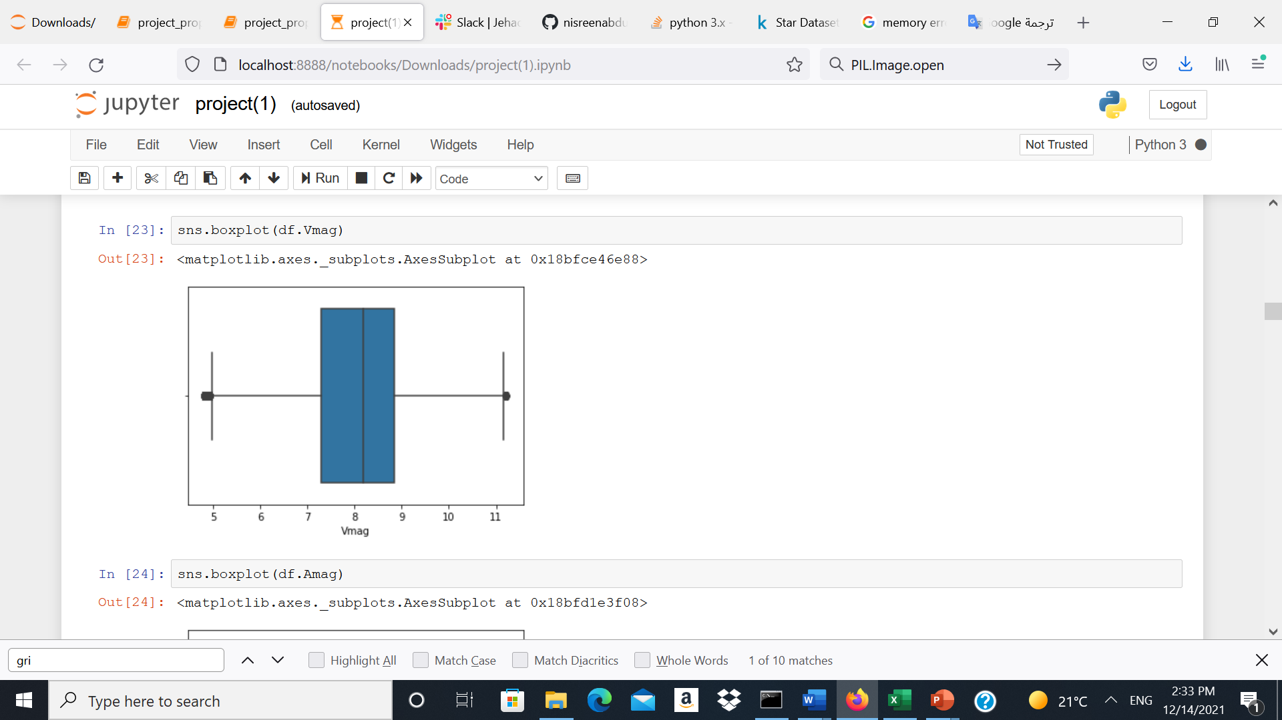
EDA(Removing outliers)
I remove the outliers for all the numerical data my using IQR
After EDA the dataset becomes 33175 rows and 2074 columns

Slide 9
Modeling :
80%
1O%
1O%
Training
Vailidation
Test

Slide 10
Modeling(Defult values) :
 | KNN Model | Logistic Regression | Decision Tree | Random Forest | XGBoosting | Naive Bayes | SVM Model
Train | 98.02% | 100.00% | 100.00% | 100.00% | 96.51% | 100.00% | 100.00%
Validation | 97.32% | 98.49% | 96.11% | 96.50% | 95.48% | 97.53% | 98.34%

Slide 11
Tuning my best models
SVM
Logistic Regression
Before Tuning : 98.34%
After Tuning hyperparameter: increased Accuracy: 98.58%
Using polynomial caused memory error
Before Tuning 98.49%
After Tuning and Grid search for the best hyperparameter: increased Accuracy: 98.70%
Using polynomial caused memory error

Slide 12
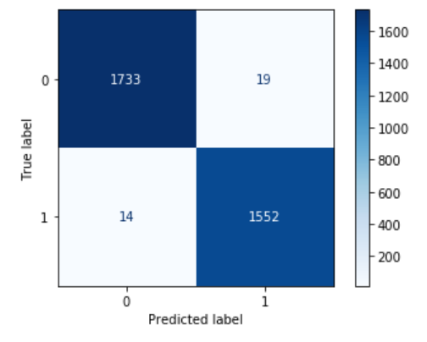
Testing my best models (Logistic Regression):
Train
validation
+
fit
Predict
Test
99.01%

Slide 13
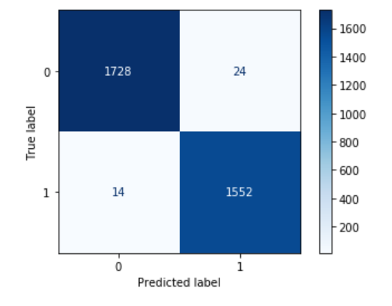
Testing my best models (SVM):
Train
validation
+
fit
Predict
Test
98.85%

Slide 14
Conclusion
After building different models, svm and Logistic Regression give me the highest accuracy in both train and validation set. but Logistic Regression slightly better than svm .

Slide 15

Future work:
Collect more data
Explore different models
Add additional memory to solve memory error

Slide 16
THANKS!
Do you have any questions?
jehad bin musallam

